Slide 1





Data Definition and Data Types
Managing DBs using IDEs
Java DB
SoftUni Team
Technical Trainers
Software University
http://softuni.bg

Slide 2
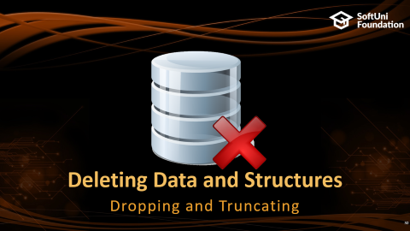
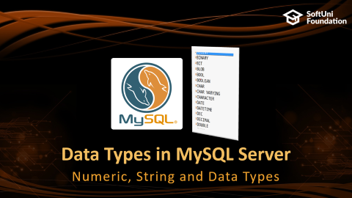
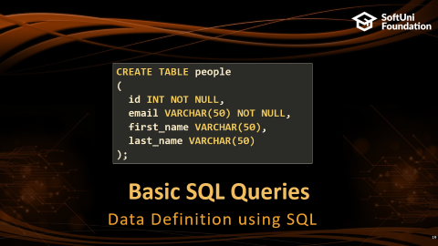
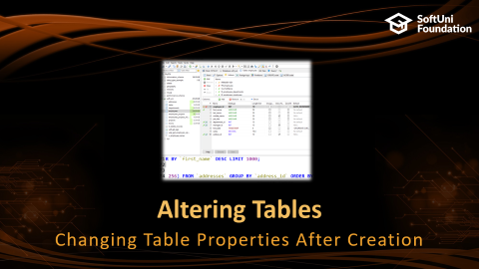
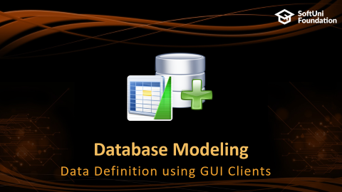

Table of Contents

Slide 3
Have a Question?
sli.do #JavaDB

Slide 4

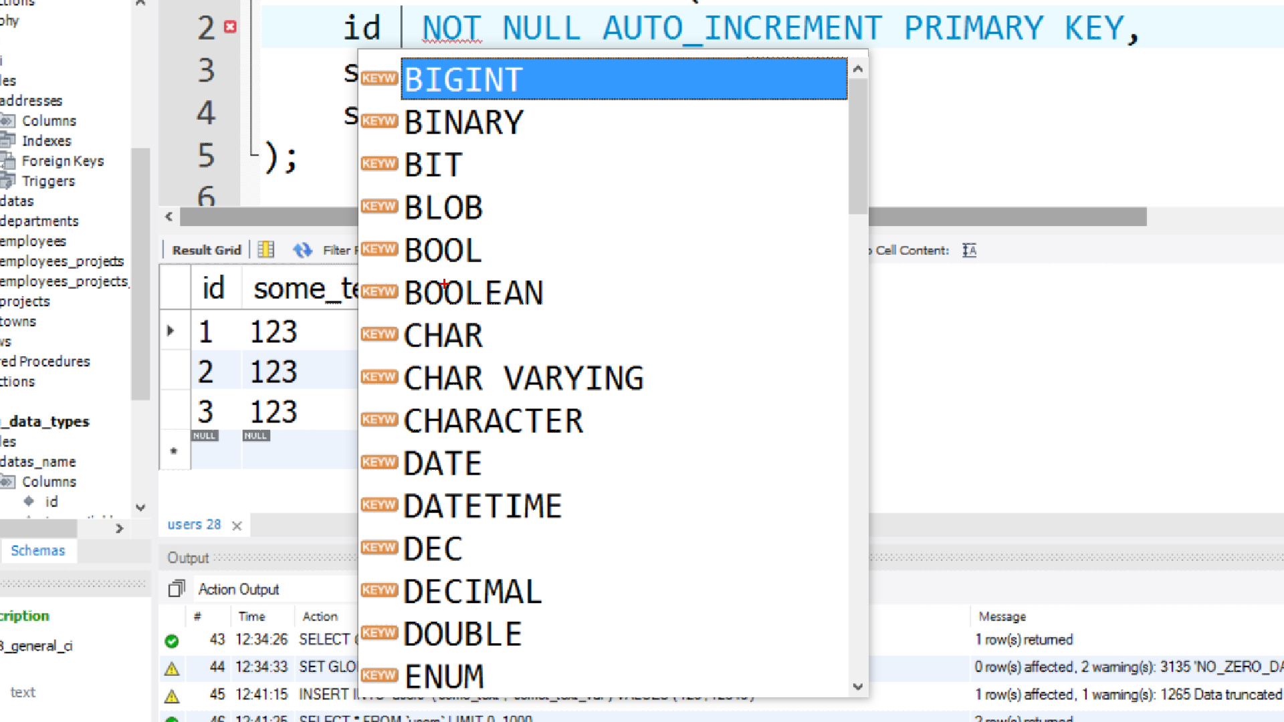
Data Types in MySQL Server
Numeric, String and Data Types

Slide 5
Numeric Data Types
Numeric data types have certain range
Their range can be changed if they are:
Signed - represent numbers both in the positive and negative ranges
Unsigned - represent numbers only in the positive range
E.g. signed and unsigned INT:
Signed Range |  | Unsigned Range
Min Value | Max Value | Min Value | Max Value
-2147483648 | 2147483648 | 0 | 4294967295

Slide 6
Numeric Data Types
INT [(M)] [UNSIGNED]
TINYINT, SMALLINT, MEDIUMINT, BIGINT
DOUBLE [(M, D)] [UNSIGNED]
E.g. DOUBLE[5, 2] – 999.99
DECIMAL [(M, D )] [UNSIGNED] [ZEROFILL]
Decimals after floating point
Digits stored for value

Slide 7
String Types
String column definitions include attributes that specify the character set or collation
CHARACTER SET (Encoding)
E.g. utf8, ucs2
CHARACTER COLLATION – rules for encoding comparison
E.g. latin1_general_cs, Traditional_Spanish_ci_ai etc.
Set and collation can be defined at the database, table or column level
Determines the storage of each character (single or multiple bytes)
Determines the sorting order and case-sensitivity

Slide 8
CHARACTER COLLATION - Example
ORDER BY with different collations
latin1_swedish_ci | latin1_german1_ci | latin1_german2_ci
Muffler | Muffler | Müller
MX Systems | Müller | Muffler
Müller | MX Systems | MX Systems
MySQL | MySQL | MySQL

Slide 9
String Types (2)
CHAR [(M)] - up to 30 characters
VARCHAR(M) – up to 255 characters
TEXT [(M)] – up to 65 535 characters
TINYTEXT, MEDIUMTEXT, LONGTEXT
BLOB - Binary Large OBject [(M)] - 65 535 (2¹⁶ − 1) characters
TINYBLOB, MEDIUMBLOB, LONGBLOB
Column name | Column Type
title | VARCHAR(CHAR)
content | TEXT(LONGTEXT)
picture | BLOB(LONGBLOB)

Slide 10
Date Types
DATE - for values with a date part but no time part
TIME - for values with time but no date part
DATETIME - values that contain both date and time parts
TIMESTAMP - both date and time parts
DATETIME and TIMESTAMP have different time ranges
Column name | Column Type
birthdate | DATE
last_time_online | TIMESTAMP
start_at | TIME
deleted_on | DATETIME

Slide 11
Date Types (2)
MySQL retrieves values for a given date type in a standard output format
E.g. as a string in either 'YYYY-MM-DD' or 'YY-MM-DD'
Data Type | Column Type
DATE | '0000-00-00'
TIME | '00:00:00'
DATETIME | '0000-00-00 00:00:00'
TIMESTAMP | '0000-00-00 00:00:00'
YEAR | 0000

Slide 12


Database Modeling
Data Definition using GUI Clients

Slide 13

Working with IDEs
We will manage databases with HeidiSQL
Enables us:
To create a new database
To create objects in the database (tables, stored procedures, relationships and others)
To change the properties of objects
To enter records into the tables

Slide 14
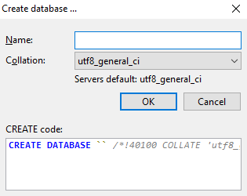

Creating a New Database
Select the instance Create new -> Database from the context menu

Slide 15

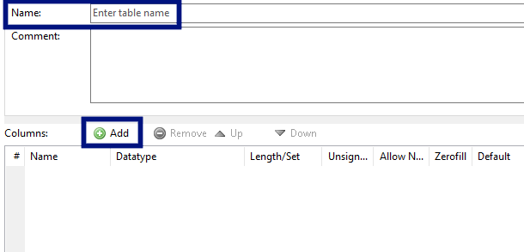
Creating Tables
Right click on database Select Create new -> Table
Set up table name
Add new record

Slide 16
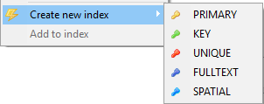
Creating Tables (2)
A Primary Key is used to uniquely identify and index records
Click on row Create new index -> Primary from the context menu of the desired row

Slide 17
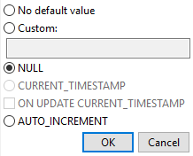
Creating Tables (3)
Auto increment – on the "Default" field

Slide 18

Storing and Retrieving Data
We can add, modify and read records with GUI Clients
To insert or edit a record, click inside the cell

Slide 19
Basic SQL Queries
CREATE TABLE people
(
id INT NOT NULL,
email VARCHAR(50) NOT NULL,
first_name VARCHAR(50),
last_name VARCHAR(50)
);
Data Definition using SQL

Slide 20
SQL Queries
We communicate with the database engine using SQL
Queries provide greater control and flexibility
To create a database using SQL:
SQL keywords are conventionally capitalized
Database name
CREATE DATABASE employees;

Slide 21
Table Creation in SQL
Table name
CREATE TABLE people
(
id INT NOT NULL,
email VARCHAR(50) NOT NULL,
first_name VARCHAR(50),
last_name VARCHAR(50)
);
Custom properties
Column name
Data type

Slide 22
Retrieve Records in SQL
Get all information from a table
You can limit the columns and number of records
Table name
SELECT * FROM employees;
SELECT first_name, last_name FROM employees LIMIT 5;
List of columns
Number of records

Slide 23

Table Customization
Adding Rules, Constraints and Relationships

Slide 24
Custom Column Properties
Primary Key
Auto-Increment (Identity)
Unique constraint – no repeating values in entire table
Default value – if not specified (otherwise set to NULL)
id INT NOT NULL PRIMARY KEY
id INT AUTO_INCREMENT PRIMARY KEY
email VARCHAR(50) UNIQUE
balance DECIMAL(10,2) DEFAULT 0

Slide 25
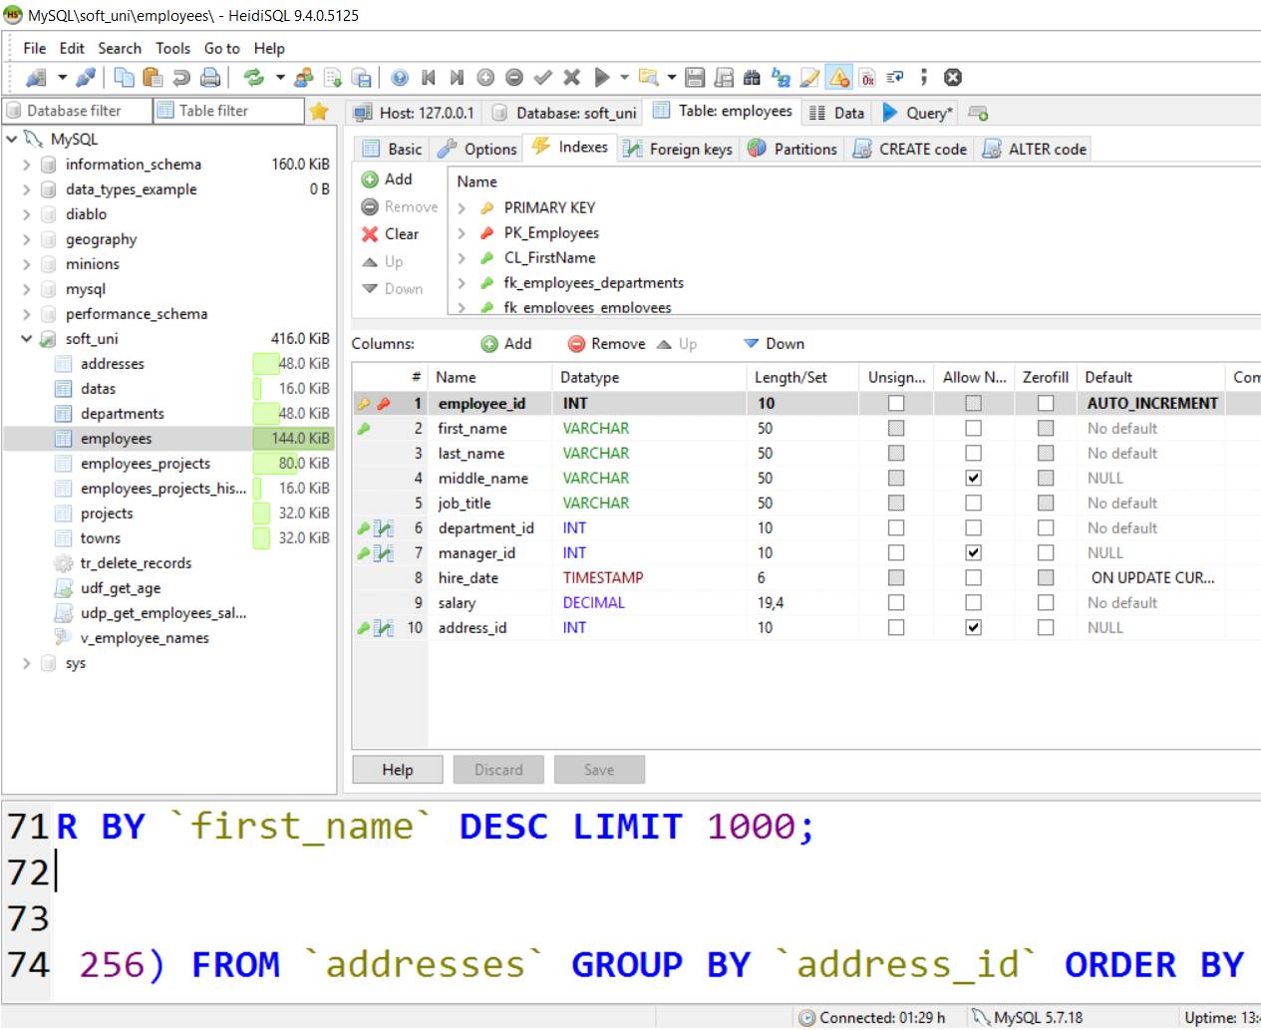
Altering Tables
Changing Table Properties After Creation

Slide 26
Altering Tables Using SQL
A table can be changed using the keywords ALTER TABLE
Add new column
ALTER TABLE employees;
Table name
ALTER TABLE employees
ADD salary DECIMAL;
Column name
Data type

Slide 27
Altering Tables Using SQL (2)
Delete existing column
Modify data type of existing column
Column name
ALTER TABLE people
DROP COLUMN full_name;
ALTER TABLE people MODIFY COLUMN email VARCHAR(100);
Column name
New data type

Slide 28
Altering Tables Using SQL (3)
Add primary key to existing column
Add unique constraint
Constraint name
ALTER TABLE people ADD CONSTRAINT pk_id
PRIMARY KEY (id);
Column name
(more than one for composite key)
Constraint name
ALTER TABLE people ADD CONSTRAINT uq_email
UNIQUE (email)
Columns name(s)

Slide 29
Altering Tables Using SQL (4)
Set default value
Default value
ALTER TABLE people ALTER COLUMN balance SET DEFAULT 0;
Column name

Slide 30

Deleting Data and Structures
Dropping and Truncating

Slide 31
Deleting from Database
Deleting structures is called dropping
You can drop keys, constraints, tables and entire databases
Deleting all data in a table is called truncating
Both of these actions cannot be undone – use with caution!

Slide 32
Dropping and Truncating
To delete all the entries in a table
To drop a table – delete data and structure
To drop entire database
TRUNCATE TABLE employees;
Table name
DROP TABLE employees;
Table name
Database name
DROP DATABASE soft_uni;

Slide 33
Dropping and Truncating (2)
To remove a constraining rule from a column
Primary keys, value constraints and unique fields
To remove DEFAULT value (if not specified, revert to NULL)
Table name
ALTER TABLE employess DROP CONSTRAINT pk_id;
Constraint name
Table name
ALTER TABLE employess ALTER COLUMN clients
DROP DEFAULT;
Columns name

Slide 34

Summary
Table columns have a fixed type
We can use GUI Clients to create and customize tables
SQL provides greater control
CREATE TABLE people
(
id INT NOT NULL,
email VARCHAR(50) NOT NULL,
first_name VARCHAR(50),
last_name VARCHAR(50)
);

Slide 35







Data Definition and Data Types
https://softuni.bg/courses/databases-basics-mysql

Slide 36
License
This course (slides, examples, demos, videos, homework, etc.) is licensed under the "Creative Commons Attribution-NonCommercial-ShareAlike 4.0 International" license
Attribution: this work may contain portions from
"Databases" course by Telerik Academy under CC-BY-NC-SA license

Slide 37





Free Trainings @ Software University
Software University Foundation – softuni.org
Software University – High-Quality Education, Profession and Job for Software Developers
softuni.bg
Software University @ Facebook
facebook.com/SoftwareUniversity
Software University Forums
forum.softuni.bg

Slide 38

Summary
Table columns have a fixed type
We can use GUI Clients to create and customize tables
SQL provides greater control
CREATE TABLE people
(
id INT NOT NULL,
email VARCHAR(50) NOT NULL,
first_name VARCHAR(50),
last_name VARCHAR(50)
);

Slide 39
Database Basics MySQL – DDL
https://softuni.bg/courses/databases-basics-mysql

Slide 40
License
This course (slides, examples, demos, videos, homework, etc.) is licensed under the "Creative Commons Attribution-NonCommercial-ShareAlike 4.0 International" license

Slide 41



Trainings @ Software University (SoftUni)
Software University – High-Quality Education, Profession and Job for Software Developers
softuni.bg
Software University Foundation
http://softuni.foundation/
Software University @ Facebook
facebook.com/SoftwareUniversity
Software University Forums
forum.softuni.bg

